Slide 1
Relational Model

Slide 2

Example of a Relation

Slide 3
Attribute Types
Each attribute of a relation has a name
The set of allowed values for each attribute is called the domain of the attribute
Attribute values are (normally) required to be atomic; that is, indivisible
  E.g. the value of an attribute can be an account number,
  but cannot be a set of account numbers
Domain is said to be atomic if all its members are atomic
The special value null is a member of every domain
The null value causes complications in the definition of many operations
  We shall ignore the effect of null values in our main presentation and consider their effect later

Slide 4
Relation Schema
A₁, A₂, …, A_{n} are attributes
R = (A₁, A₂, …, A_{n} ) is a relation schema
Example:
Customer_schema = (customer_name, customer_street, customer_city)
r(R) denotes a relation r on the relation schema R
Example:
customer (Customer_schema)

Slide 5
Relation Instance
The current values (relation instance) of a relation are specified by a table
An element t of r is a tuple, represented by a row in a table
attributes
(or columns)
customer_name
customer_street
customer_city
Jones
Smith
Curry
Lindsay
Main
North
North
Park
Harrison
Rye
Rye
Pittsfield
tuples
(or rows)
customer

Slide 6
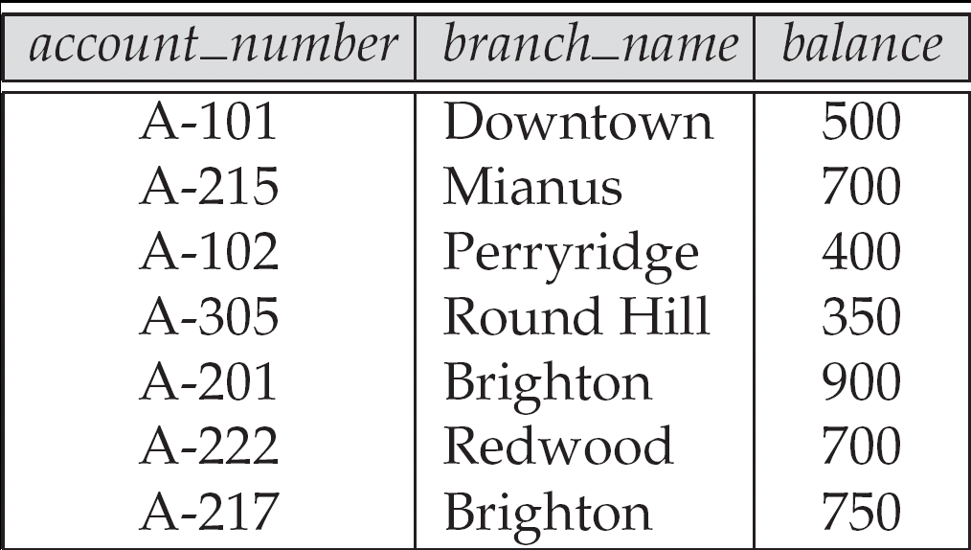
Relations are Unordered
Order of tuples is irrelevant (tuples may be stored in an arbitrary order)
Example: account relation with unordered tuples

Slide 7
Database
A database consists of multiple relations
Information about an enterprise is broken up into parts, with each relation storing one part of the information
account : stores information about accounts
depositor : stores information about which customer
owns which account
customer : stores information about customers
Storing all information as a single relation such as
bank(account_number, balance, customer_name, ..)
results in
  repetition of information
    e.g.,if two customers own an account (What gets repeated?)
  the need for null values
    e.g., to represent a customer without an account
Normalization theory deals with how to design relational schemas

Slide 8
Keys
Let K ⊆ R
K is a superkey of R if values for K are sufficient to identify a unique tuple of each possible relation r(R)
  by “possible r ” we mean a relation r that could exist in the enterprise we are modeling.
  Example: {customer_name, customer_street} and
  {customer_name}
  are both superkeys of Customer, if no two customers can possibly have the same name
    In real life, an attribute such as customer_id would be used instead of customer_name to uniquely identify customers, but we omit it to keep our examples small, and instead assume customer names are unique.

Slide 9
Keys (Cont.)
K is a candidate key if K is minimal
Example: {customer_name} is a candidate key for Customer, since it is a superkey and no subset of it is a superkey.
Primary key: a candidate key chosen as the principal means of identifying tuples within a relation
  Should choose an attribute whose value never, or very rarely, changes.
  E.g. email address is unique, but may change

Slide 10

Foreign Keys
A relation schema may have an attribute that corresponds to the primary key of another relation. The attribute is called a foreign key.
  E.g. customer_name and account_number attributes of depositor are foreign keys to customer and account respectively.
  Only values occurring in the primary key attribute of the referenced relation may occur in the foreign key attribute of the referencing relation.
Schema diagram

Slide 11
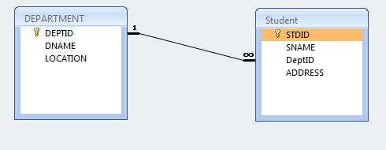
FOREIGN KEY

Slide 12
Query Languages
Language in which user requests information from the database.
Categories of languages
  Procedural
  Non-procedural, or declarative
“Pure” languages:
  Relational algebra
  Tuple relational calculus
  Domain relational calculus
Pure languages form underlying basis of query languages that people use.

Slide 13
SQL (Structured Query Language)
SQL: widely used non-procedural language
  Example: Find the name of the customer with customer-id 192-83-7465
  select customer.customer_name
  from customer
  where customer.customer_id = ‘192-83-7465’
  Example: Find the balances of all accounts held by the customer with customer-id 192-83-7465
  select account.balance
  from depositor, account
  where depositor.customer_id = ‘192-83-7465’ and
  depositor.account_number = account.account_number
Application programs generally access databases through one of
  Language extensions to allow embedded SQL
  Application program interface (e.g., ODBC/JDBC) which allow SQL queries to be sent to a database

Slide 14
Database Design
The process of designing the general structure of the database:
Logical Design – Deciding on the database schema. Database design requires that we find a “good” collection of relation schemas.
  Business decision – What attributes should we record in the database?
  Computer Science decision – What relation schemas should we have and how should the attributes be distributed among the various relation schemas?
Physical Design – Deciding on the physical layout of the database

Slide 15

The Entity-Relationship Model
Models an enterprise as a collection of entities and relationships
  Entity: a “thing” or “object” in the enterprise that is distinguishable from other objects
    Described by a set of attributes
  Relationship: an association among several entities
Represented diagrammatically by an entity-relationship diagram:

Slide 16
Database Users
Users are differentiated by the way they expect to interact with
the system
Application programmers – interact with system through DML calls
Sophisticated users – form requests in a database query language
Specialized users – write specialized database applications that do not fit into the traditional data processing framework
Naïve users – invoke one of the permanent application programs that have been written previously
  Examples, people accessing database over the web, bank tellers, clerical staff

Slide 17
Database Administrator
Coordinates all the activities of the database system; the database administrator has a good understanding of the enterprise’s information resources and needs.
Database administrator's duties include:
  Schema definition
  Storage structure and access method definition
  Schema and physical organization modification
  Granting user authority to access the database
  Specifying integrity constraints
  Acting as liaison with users
  Monitoring performance and responding to changes in requirements

Slide 18
SQL
Data Definition Language (DDL)
  Create/alter/delete tables and their attributes
Data Manipulation Language (DML)
  Query one or more tables
  Insert/delete/modify tuples in tables
Transact-SQL
  Idea: package a sequence of SQL statements → server

Slide 19
Data Types in SQL
Characters:
  CHAR(20) -- fixed length
  VARCHAR(40) -- variable length
Numbers:
  BIGINT, INT, SMALLINT, TINYINT
  REAL, FLOAT -- differ in precision
  NUMBER(n,m)
Times and dates:
  DATE

Slide 20
SQL Query
SELECT attributes
FROM relations (possibly multiple)
WHERE conditions (selections)

Slide 21
Simple SQL Query
Product
PName | Price | Category | Manufacturer
Gizmo | $19.99 | Gadgets | GizmoWorks
Powergizmo | $29.99 | Gadgets | GizmoWorks
SingleTouch | $149.99 | Photography | Canon
MultiTouch | $203.99 | Household | Hitachi
SELECT *
FROM Product
WHERE category=‘Gadgets’
PName | Price | Category | Manufacturer
Gizmo | $19.99 | Gadgets | GizmoWorks
Powergizmo | $29.99 | Gadgets | GizmoWorks
“selection”

Slide 22
Simple SQL Query
Product
PName | Price | Category | Manufacturer
Gizmo | $19.99 | Gadgets | GizmoWorks
Powergizmo | $29.99 | Gadgets | GizmoWorks
SingleTouch | $149.99 | Photography | Canon
MultiTouch | $203.99 | Household | Hitachi
SELECT PName, Price, Manufacturer
FROM Product
WHERE Price > 100
PName | Price | Manufacturer
SingleTouch | $149.99 | Canon
MultiTouch | $203.99 | Hitachi
“selection” and
“projection”

Slide 23
Selections
What goes in the WHERE clause:
x = y, x < y, x <= y, x<>y,x>y,x>=y
  For number, they have the usual meanings
  For CHAR and VARCHAR: lexicographic ordering
  s LIKE p: pattern matching on strings
Product(PName, Price, Category, Manufacturer)
Find all products whose name mentions ‘gizmo’:
SELECT *
FROM Products
WHERE PName LIKE ‘%gizmo%’

Slide 24
Eliminating Duplicates
Category
Gadgets
Photography
Household
SELECT DISTINCT category
FROM Product
Compare to:
Category
Gadgets
Gadgets
Photography
Household
SELECT category
FROM Product

Slide 25
Ordering the Results
SELECT pname, price, manufacturer
FROM Product
WHERE category=‘gizmo’ AND price > 50
ORDER BY price, pname
Ordering is ascending, unless you specify the DESC keyword.
Ties are broken by the second attribute on the ORDER BY list, etc.

Slide 26
Aggregate Functions
The following are the most commonly used SQL aggregate functions:
AVG – calculates the average of a set of values.
COUNT – counts rows in a specified table or view.
MIN – gets the minimum value in a set of values.
MAX – gets the maximum value in a set of values.
SUM – calculates the sum of values.
SELECT COUNT(*) FROM products;

Slide 27
SQL GROUP BY
The GROUP BY statement groups rows that have the same values into summary rows, like "find the number of customers in each country".
The GROUP BY statement is often used with aggregate functions (COUNT, MAX, MIN, SUM, AVG) to group the result-set by one or more columns.
SELECT COUNT(CustomerID), Country
FROM Customers
GROUP BY Country;
SELECT MAX(SNAME),DEPTID FROM STUDENT
GROUP BY DEPTID;

Slide 28
SQL HAVING Clause
The HAVING clause was added to SQL because the WHERE keyword could not be used with aggregate functions.
SELECT COUNT(CustomerID), Country
FROM Customers
GROUP BY Country
HAVING COUNT(CustomerID) > 5;
SELECT SNAME FROM STUDENT
GROUP BY DEPTID
HAVING AVG(MARKS)>85;

Slide 29
DUAL
DUAL is a dummy table which is a special table used for evaluating expressions
or calling functions.
SELECT * FROM dual;
SELECT UPPER('This is a string') FROM dual;
SELECT (10 + 5)/2 FROM dual;
SELECT SYSDATE FROM dual;

Slide 30
Join
Working with multiple table
1) Cross
2) Inner Join
3) Outer Join
- Left Outer
- Right Outer
- Full Outer

Slide 31
Cartesian Product
Table One
X | A
1 | a
4 | d
2 | b
Table Two
X | B
2 | x
3 | y
5 | v
3 rows
X
3 rows
Result Set
X | A | X | B
1 | a | 2 | x
1 | a | 3 | y
1 | a | 5 | v
4 | d | 2 | x
4 | d | 3 | y
4 | d | 5 | v
2 | b | 2 | x
2 | b | 3 | y
2 | b | 5 | v
9 rows
...

Slide 32
Inner Joins: WHERE Clause Restricts Rows
Table One
X | A
1 | a
4 | d
2 | b
Table Two
X | B
2 | x
3 | y
5 | v
select *
from one, two
where one.x=two.x;
X | A | X | B
1 | a | 2 | x
1 | a | 3 | y
1 | a | 5 | v
4 | d | 2 | x
4 | d | 3 | y
4 | d | 5 | v
2 | b | 2 | x
2 | b | 3 | y
2 | b | 5 | v
X | A | B
2 | B | x
Final
...

Slide 33
Display all combinations of rows with matching keys, including duplicates.
Table Three
X | A
1 | a1
1 | a2
2 | b1
2 | b2
4 | d
Table Four
X | B
2 | x1
2 | x2
3 | y
5 | v
Results Set
X | A | X | B
2 | b1 | 2 | x1
2 | b1 | 2 | x2
2 | b2 | 2 | x1
2 | b2 | 2 | x2
select *
from three, four
where three.x=four.x;

Slide 34
OUTER JOIN
You can retrieve both nonmatching and matching rows using an outer join.
Outer joins include left, full, and right outer joins. Outer joins can process only two tables at a time.
Left
Full
Right

Slide 35
Left Join
Table One
X | A
1 | a
4 | d
2 | b
Table Two
X | B
2 | x
3 | y
5 | v
select *
from one left join two
on one.x = two.x;
X | A | X | B
1 | a | .
2 | b | 2 | x
4 | d | .

Slide 36
Right Join
Table Two
X | B
2 | x
3 | y
5 | v
Table One
X | A
1 | a
4 | d
2 | b
select *
from two right join one
on one.x = two.x;
X | B | X | A
. |  | 1 | a
2 | x | 2 | b
. |  | 4 | d

Slide 37
Full Join
Table One
X | A
1 | a
4 | d
2 | b
Table Two
X | B
2 | x
3 | y
5 | v
select *
from one full join two
on one.x = two.x;
X | A | X | B
1 | a | .
2 | b | 2 | x
. |  | 3 | y
4 | d | .
. |  | 5 | v

